Slide 1
An Analysis of top GitHub Repositories, their Contributors, and the Languages Used
Complex Networks
Justin Gray

Slide 2
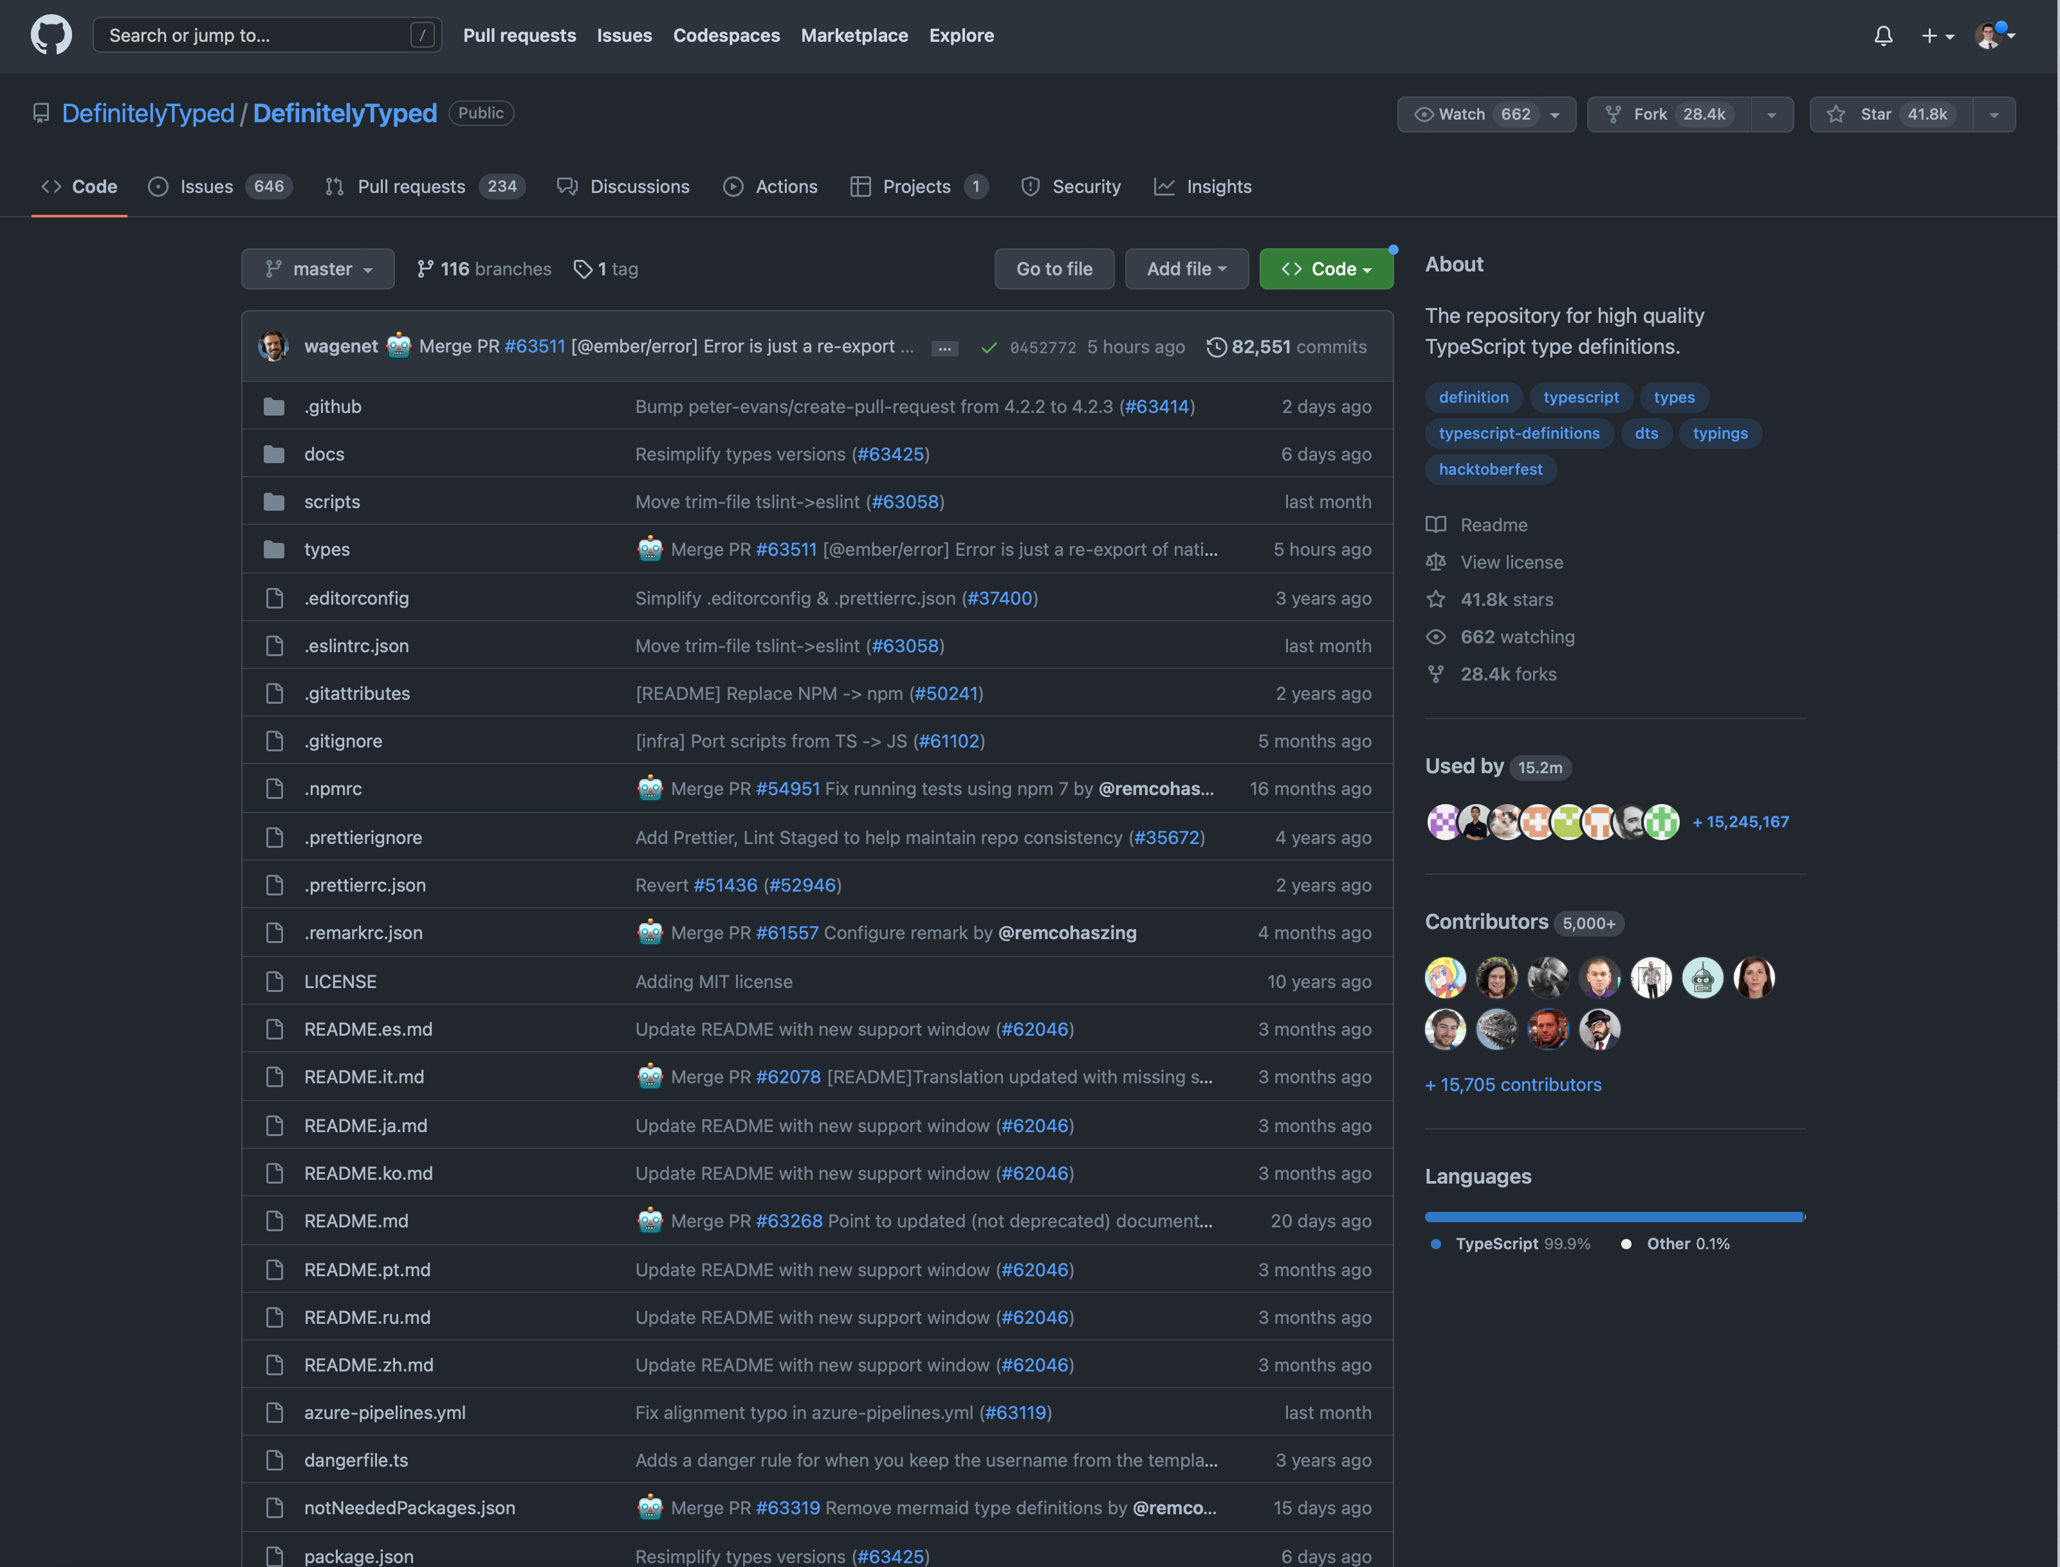


GitHub
Collaborating on source code
Versioning system with social features
Repositories
Owner
Name
#Stars
Contributors
Languages

Slide 3
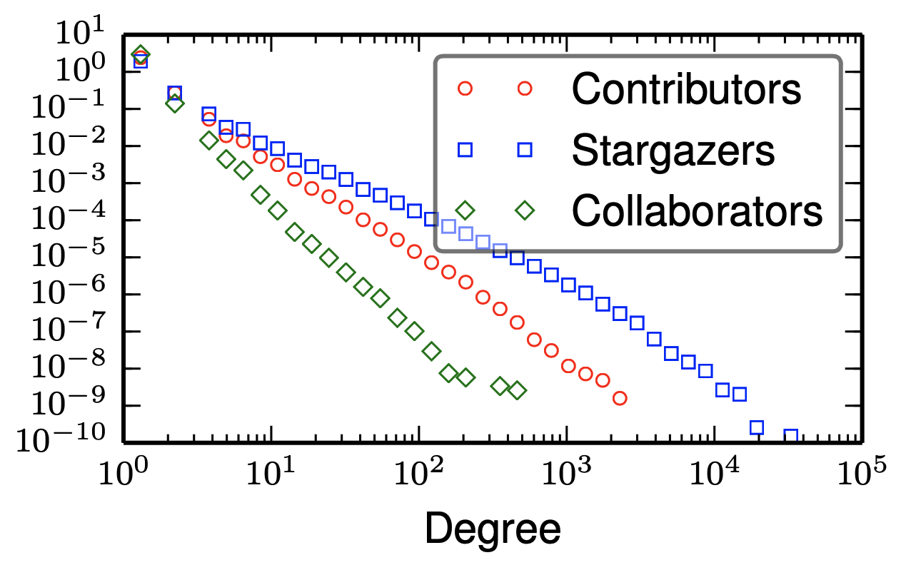
Research Questions
Reproduce results for # contributors and # stars per repository
How are open-source superstars organized in the network?
How do contributors behave between repositories?

Slide 4
Network Structure
Bipartite G = (V1, V2, E)
V1: Repositories with owner, name, stars, languages
V2: Contributors with email address
E: models “user contributed n commits to repository”

Slide 5
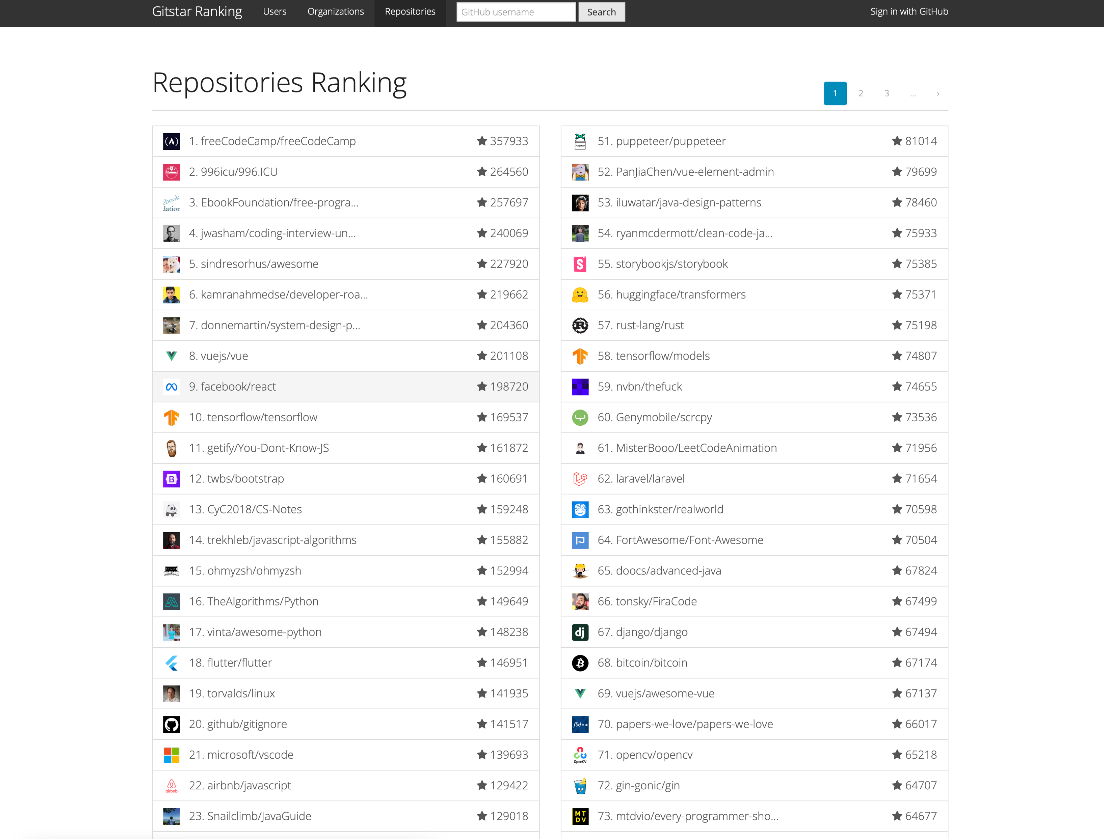
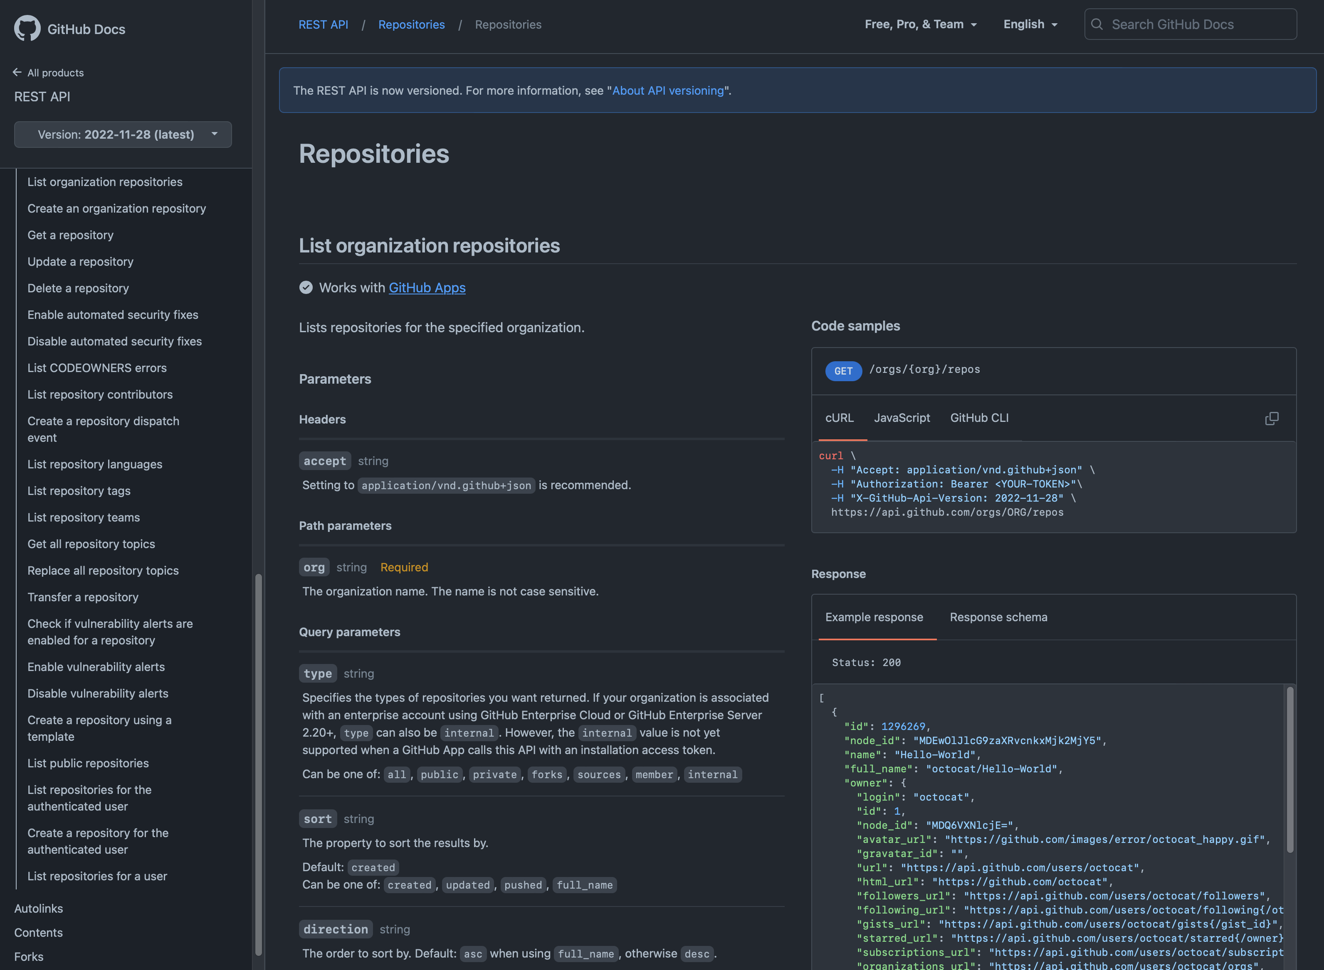

Slide 6

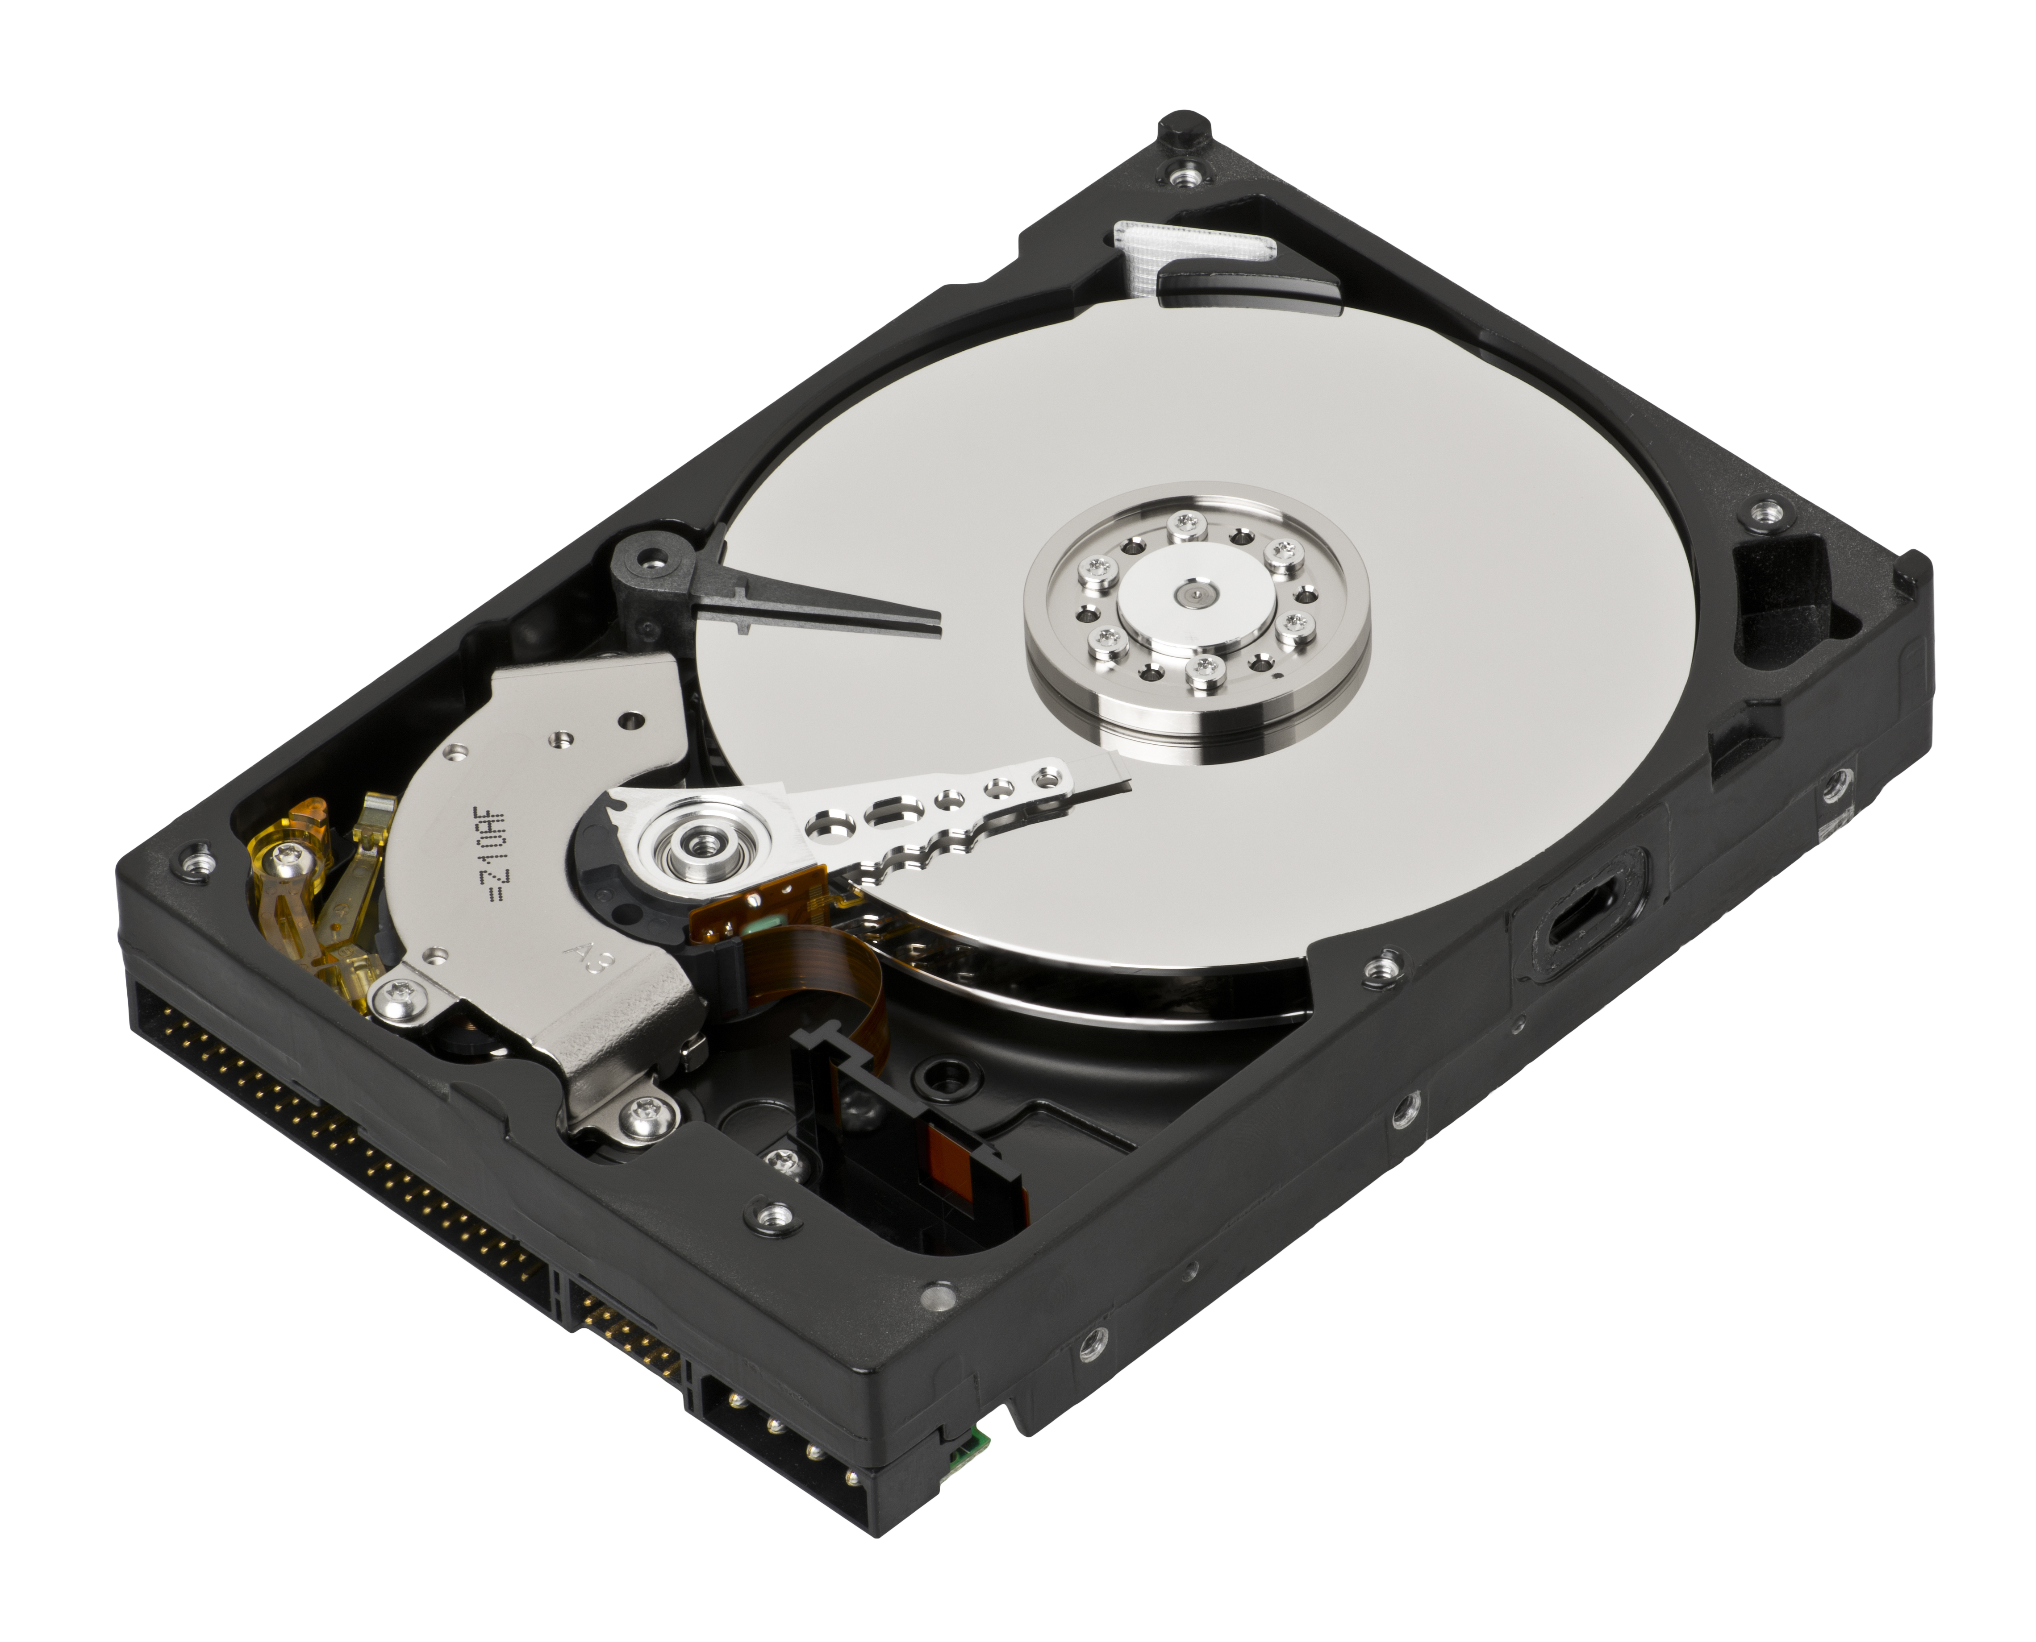
Getting all Contributors
GitHub API only returns top 100 contributors
Clone the repository --filter=tree:0
Find all contributors git shortlog --numbered --summary --email

Slide 7
The Data
CREATE TABLE IF NOT EXISTS repos (
rank INTEGER PRIMARY KEY,
owner TEXT NOT NULL,
project TEXT NOT NULL,
stars INTEGER
);
CREATE TABLE IF NOT EXISTS repo_langs (
repo INTEGER NOT NULL,
lang TEXT NOT NULL,
weight INTEGER NOT NULL,
PRIMARY KEY (repo, lang),
FOREIGN KEY (repo) REFERENCES repos (rank)
);
CREATE TABLE IF NOT EXISTS contributors (
rank INTEGER NOT NULL,
email INTEGER NOT NULL,
commits INTEGER NOT NULL,
PRIMARY KEY (rank, email),
FOREIGN KEY (rank) REFERENCES repos (rank)
);
978 repositories
347,255 contributors
466,805 edges

Slide 8
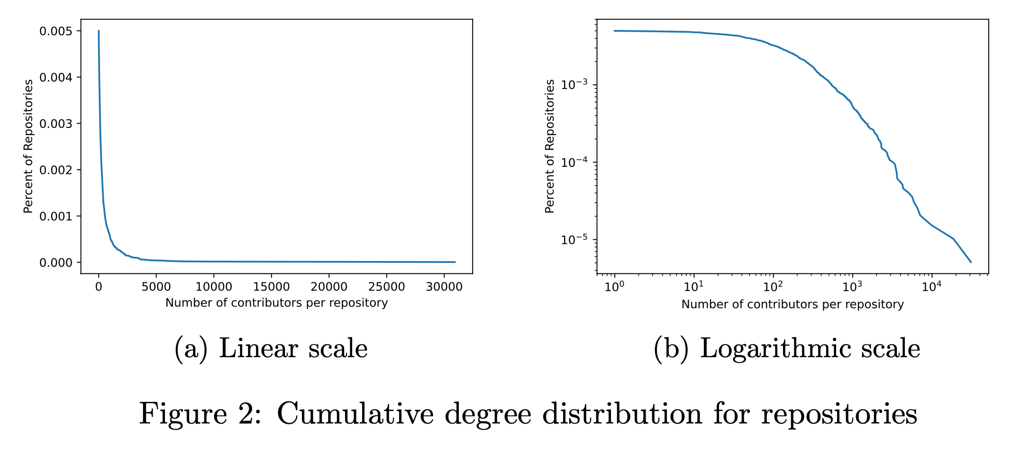
# Contributors per Repository

Slide 9
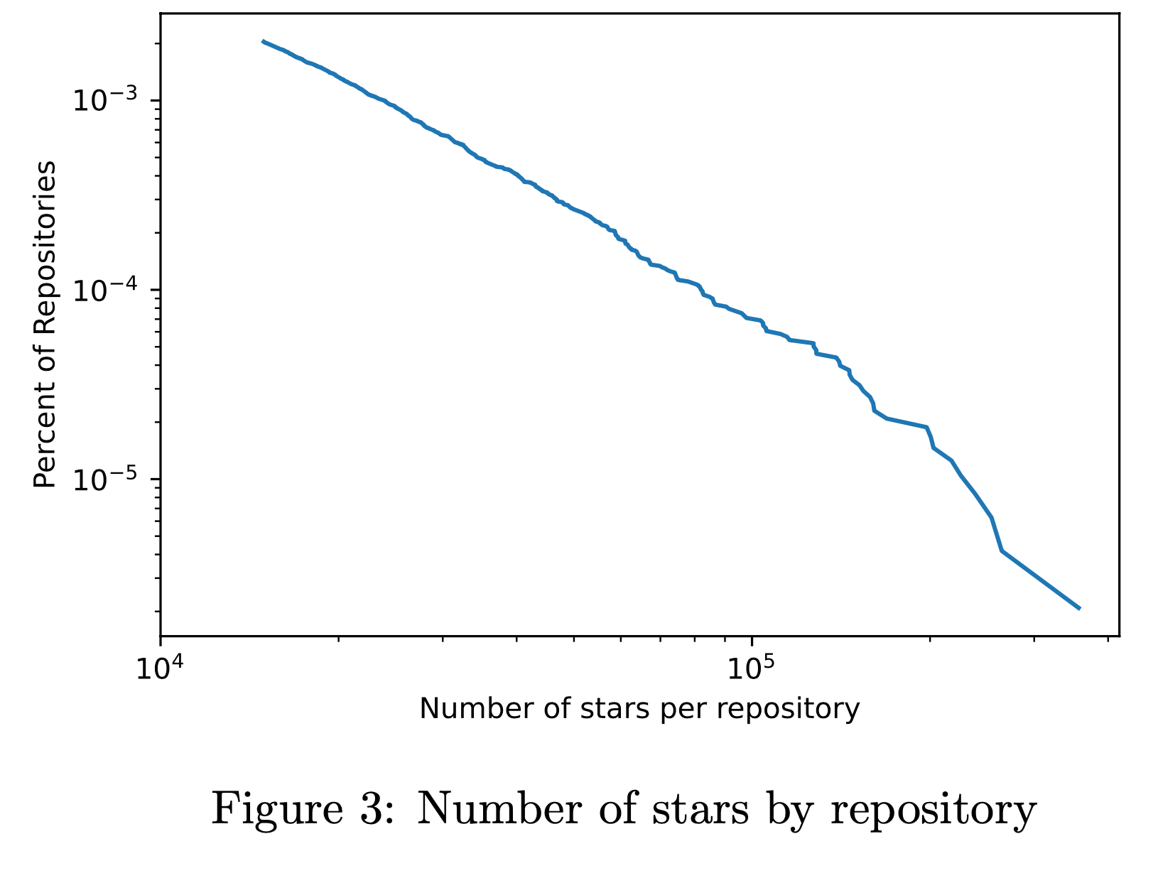
# Stars per Repository

Slide 10
Open-Source Superstars
Any user who made over 1,000 commits to the selected 978 repos
Remove any repository with no superstar contributors
 | Original Network | Superstar Network
Repositories | 978 | 738
Contributors | 347,255 | 1,604
Edges | 466,805 | 5,252

Slide 11
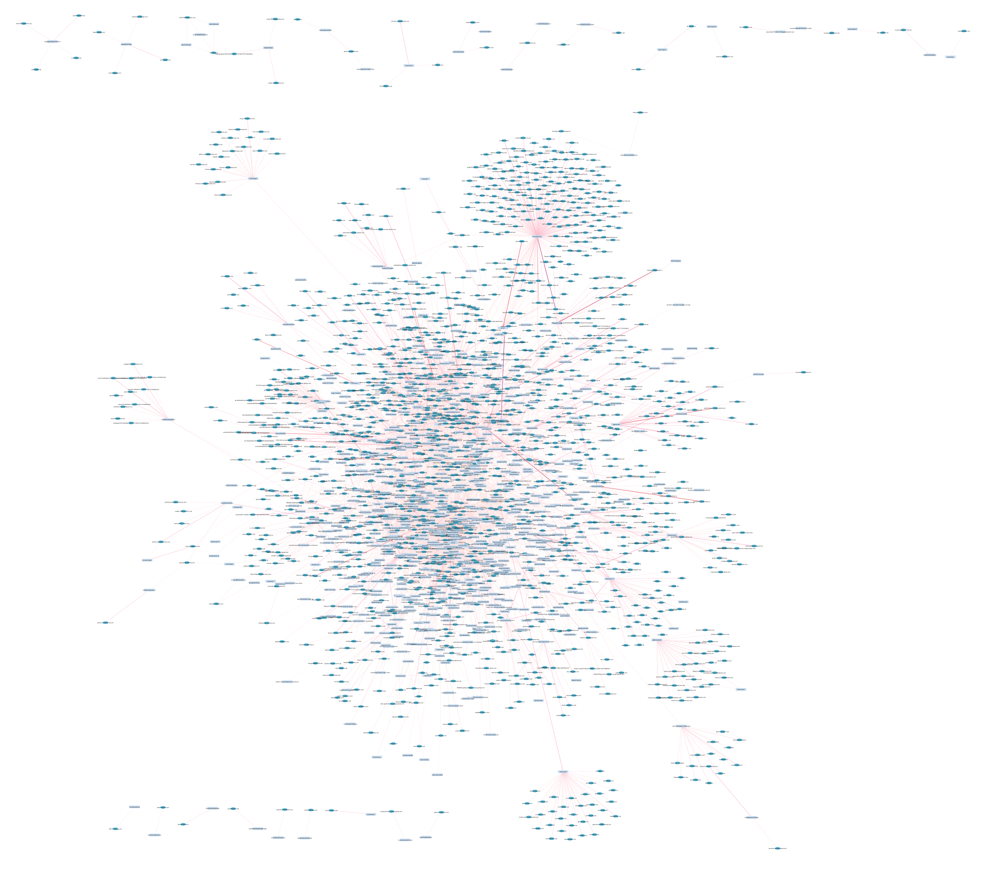

Slide 12
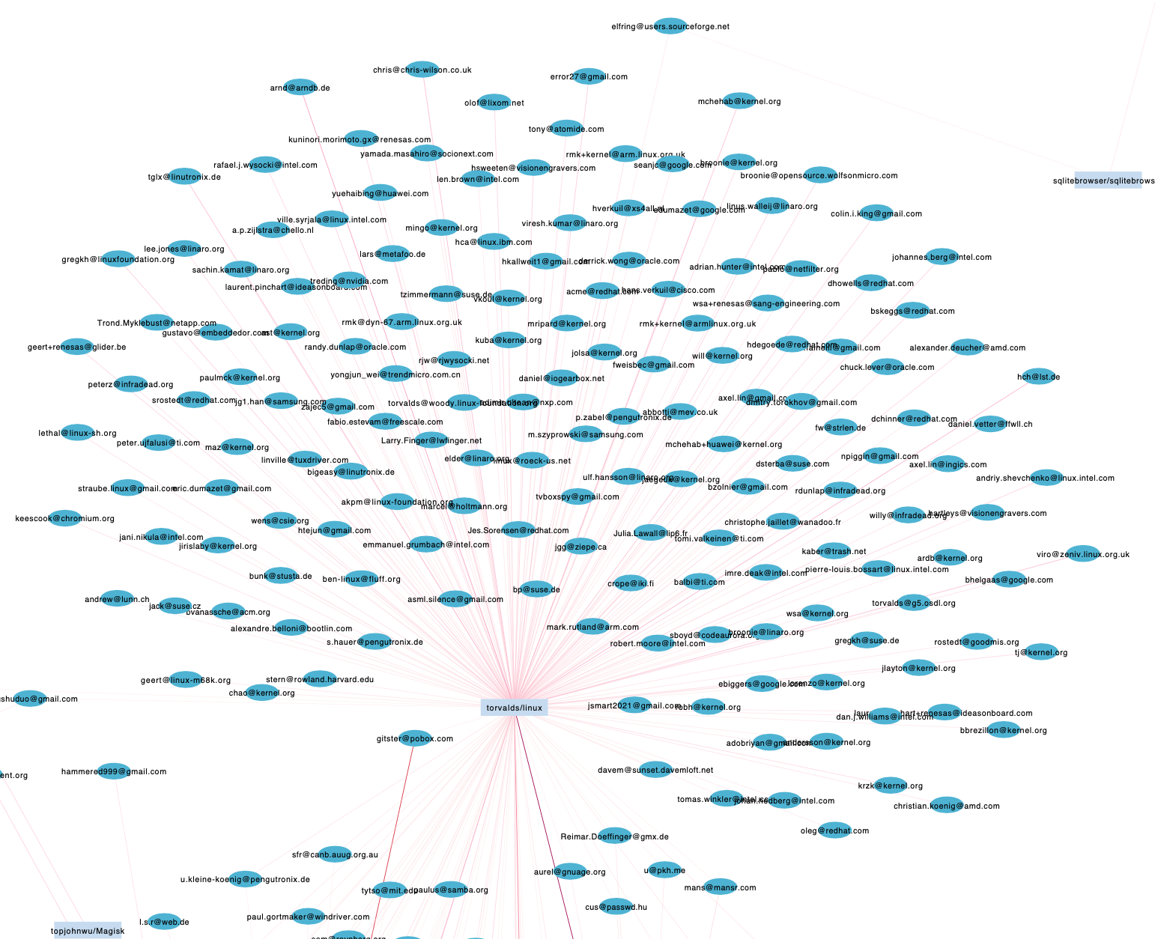

Slide 13
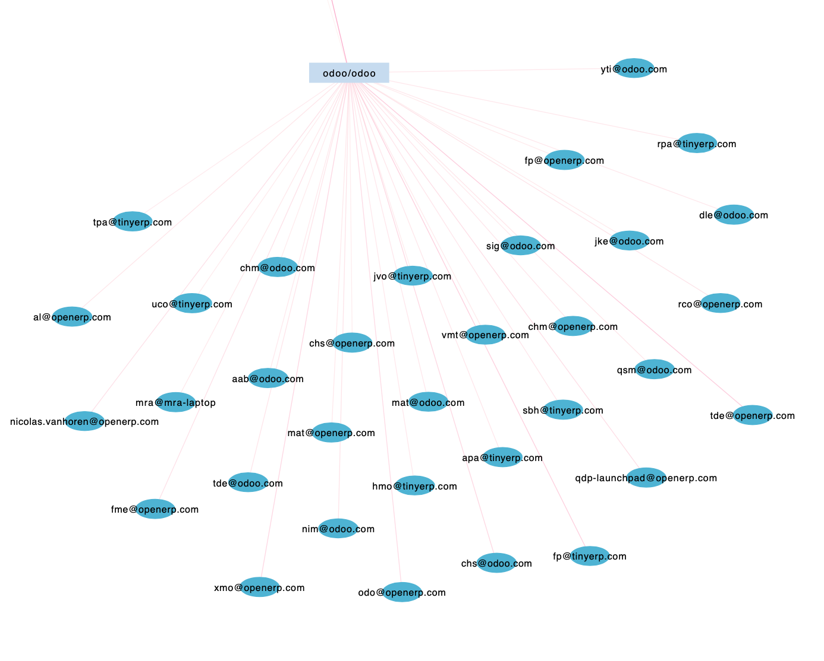

Slide 14
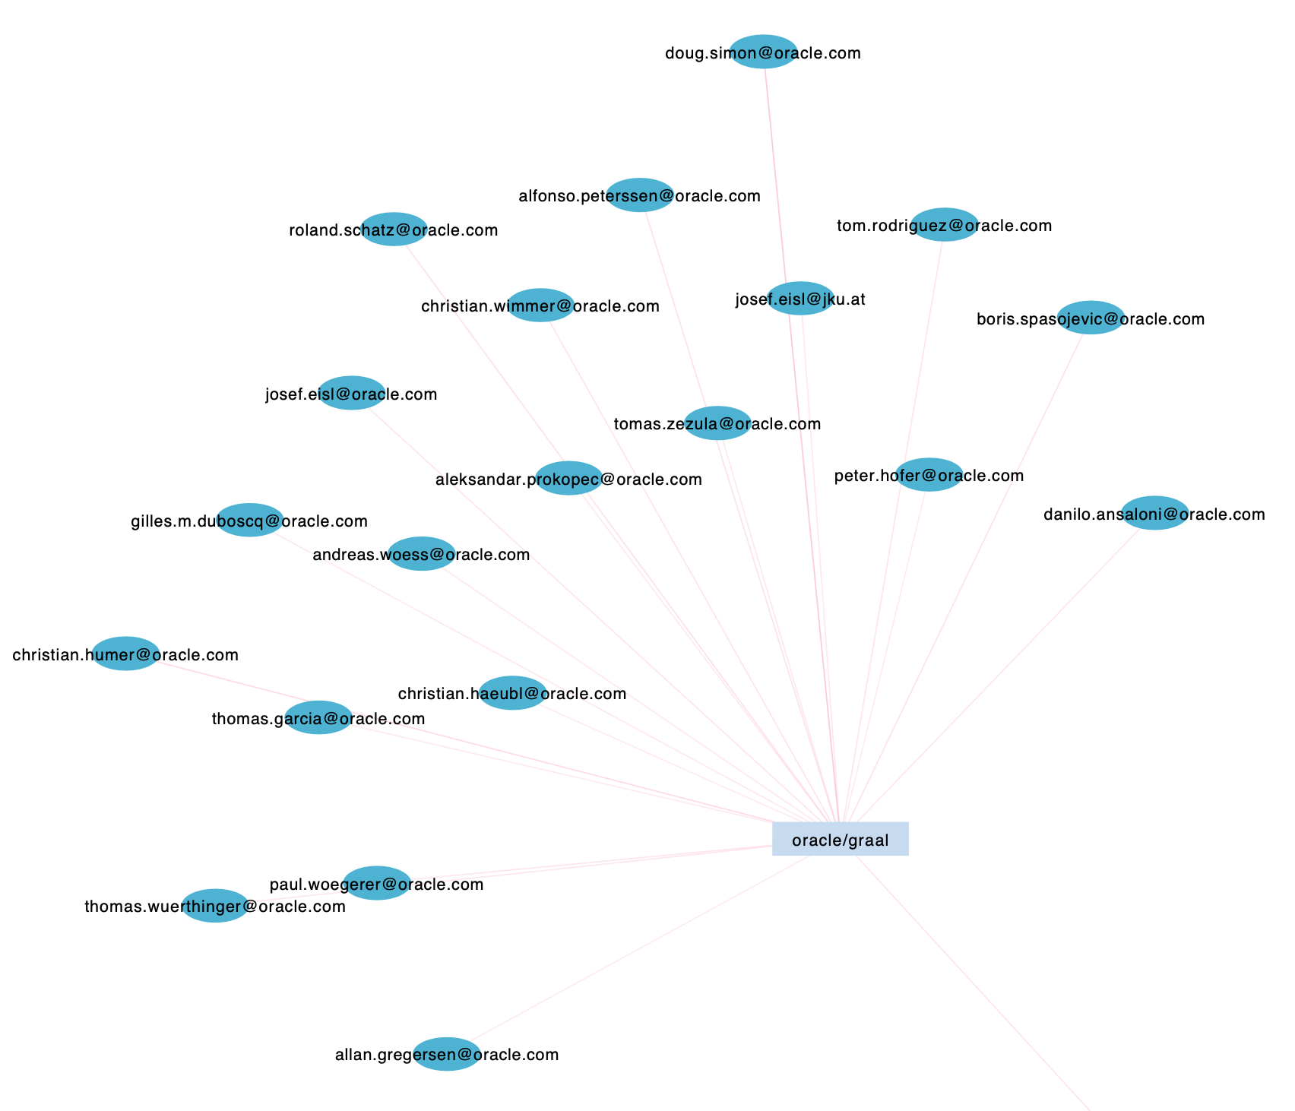

Slide 15
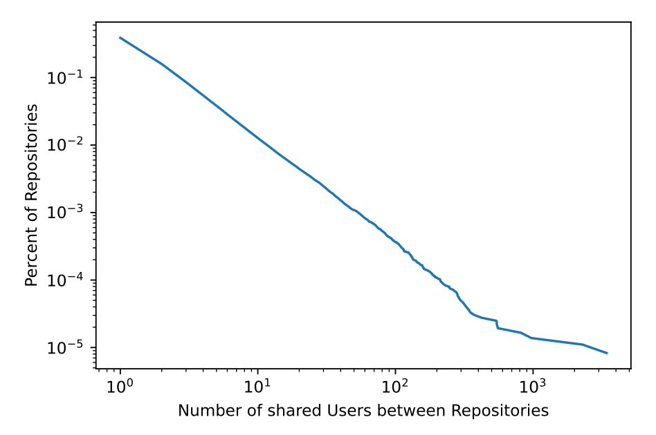
Repository Projection
Project the bipartite network onto the repositories
Edges now represent a pair of repositories having some contributors in common

Slide 16
Repository Projection
Remove all edges with less than 25 common contributors
978 nodes and 1,170 edges
2. Focus on the connected subgraphs:
358 nodes and 1,170 edges

Slide 17
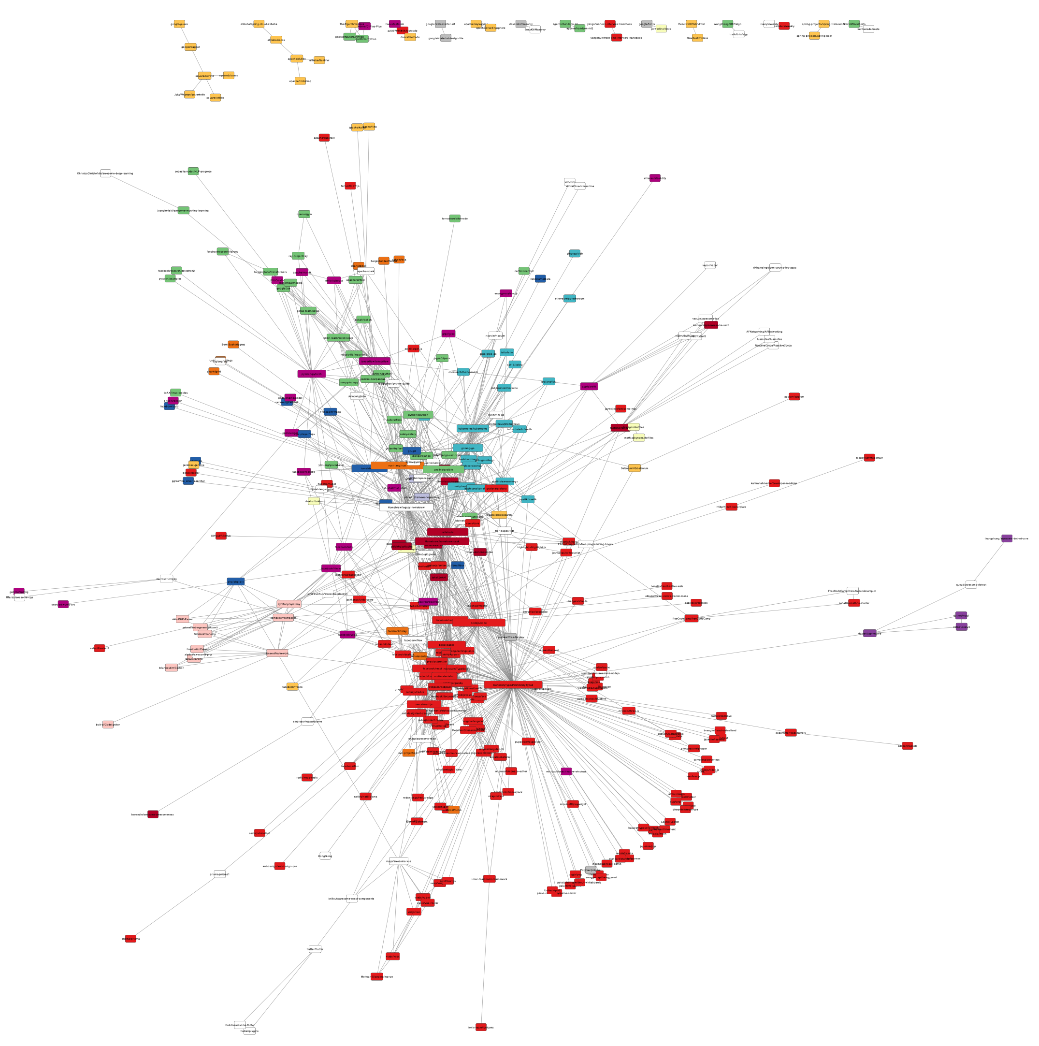
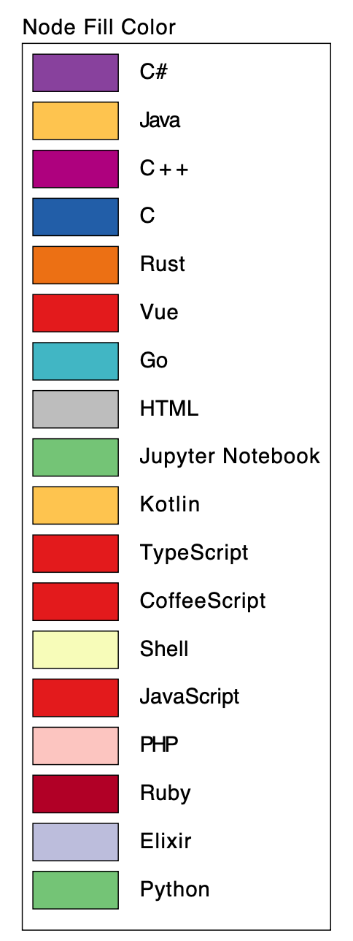
Language clusters
Expertise collaboration

Slide 18
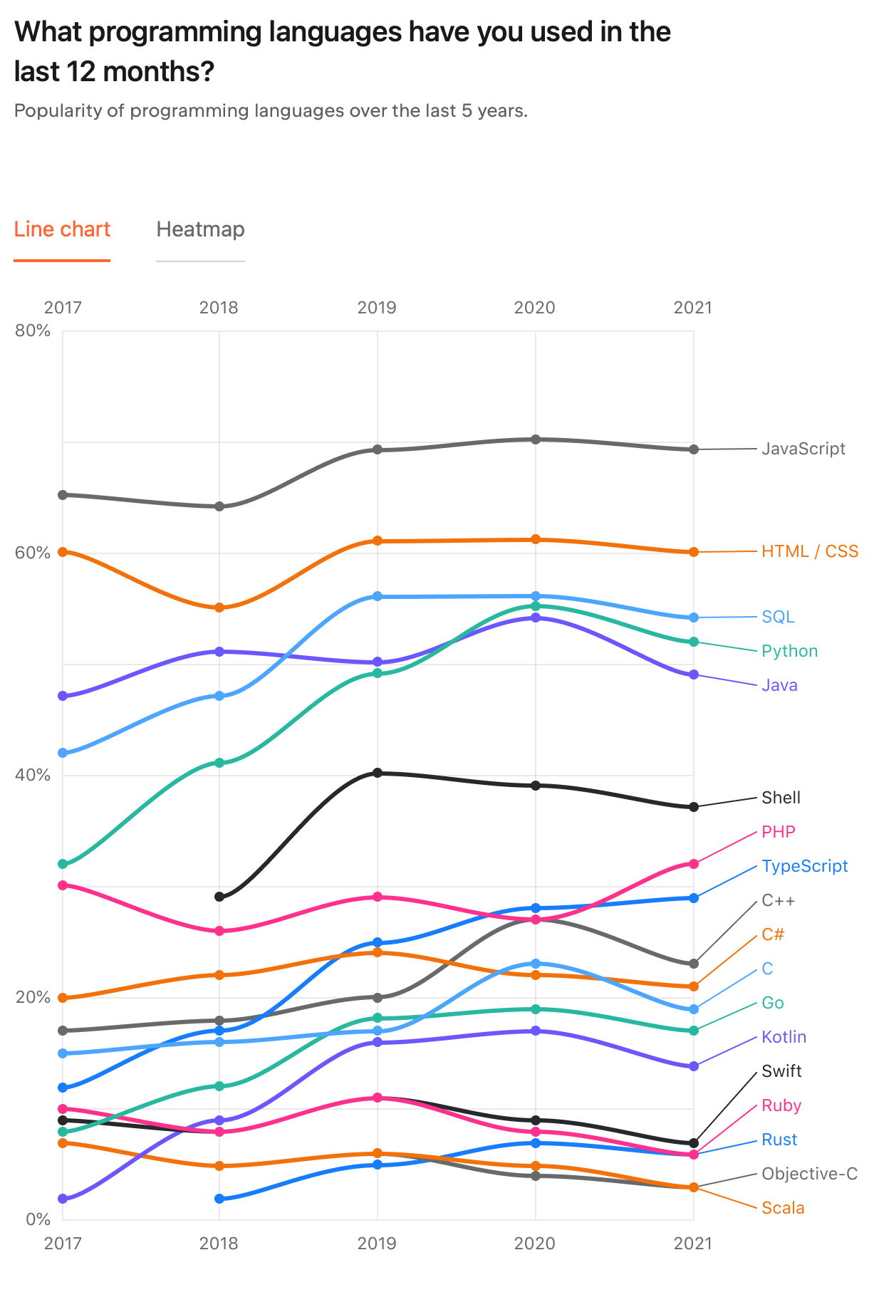
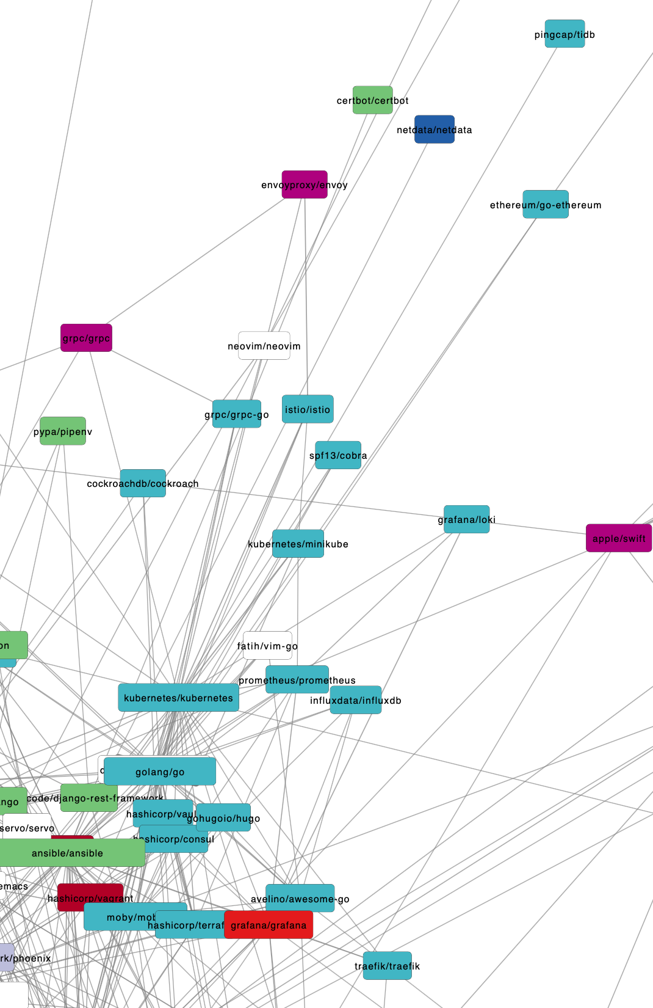

Slide 19
Thanks for your attention
Do you have any questions?

